Slide 1






Title Page
Superstore Data Analysis & Objective Setting
Group 2

Slide 2





Title Page
Proprietors
Team Members
Group 2
Kamalika Das
Keerthana Nemili
Manoj Padmaraju
Payal Pandya

Slide 3

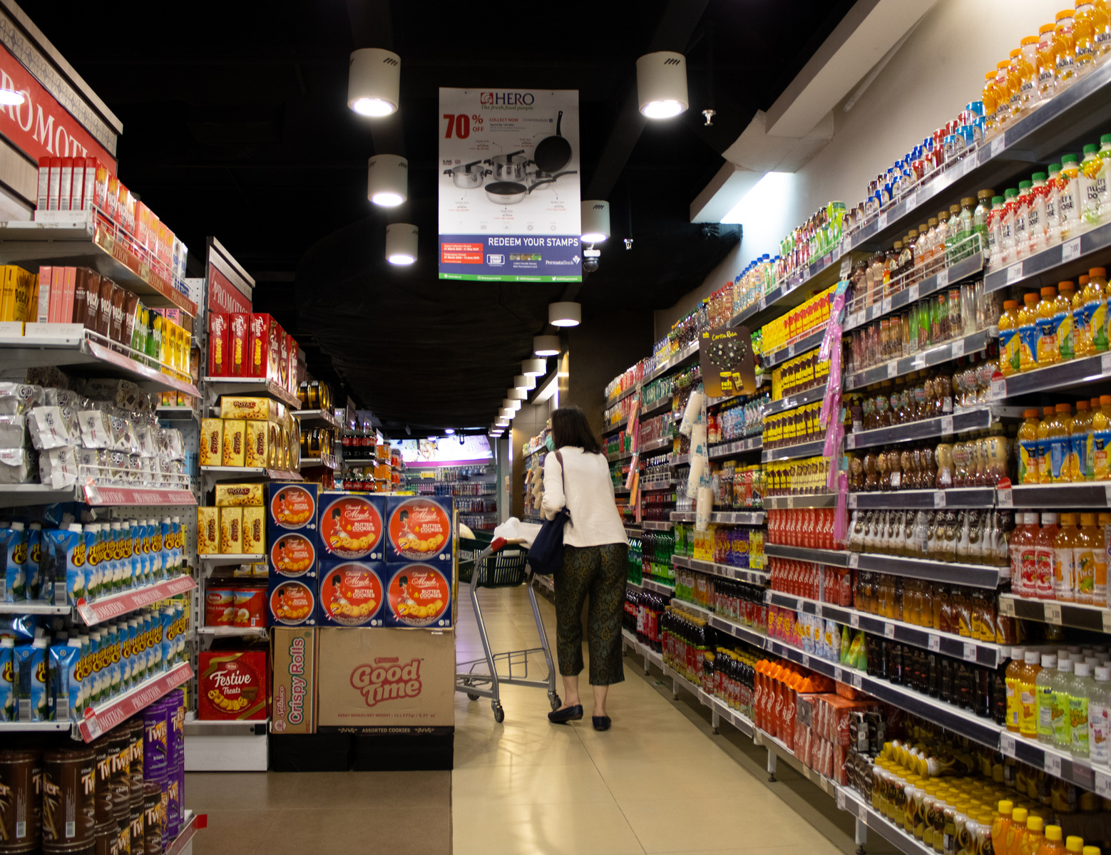
Title Page
Proprietors
Introduction
Superstore Sales Data
Introduction
Assess the factors driving the profits/loses across various categories and segments pertaining to a retail superstore located across US
First phase will provide an overview of Explanatory analysis and interaction between variables. Phase two involves building a state level goal setting engine for the superstore for each category and segment of its market

Slide 4


Title Page
Proprietors
Introduction
Objective
Objective 1
Objective 2
Analyze the Impact of shipping method, segment, categories, discount on sales quantity, and profits in order to determine the best targeting and marketing strategy
Devise a non-predictive methodology to set yearly sales objectives for each segment category for the upcoming calendar year based on historical average growth rate.

Slide 5


Title Page
Proprietors
Introduction
Data Overview
Overview of Data Set:
Categorical
Numerical
Engineered
Segment
State
Category
City
Region
Subcategory
Product ID
Product Name
Customer ID
Customer Name
Ship Mode
Order Date (MM/DD/YY)
Sales
Quantity
Discount
Profit
Population
Unit Cost Price
Gross Sales
Profit Margin
Year Order Month

Slide 6
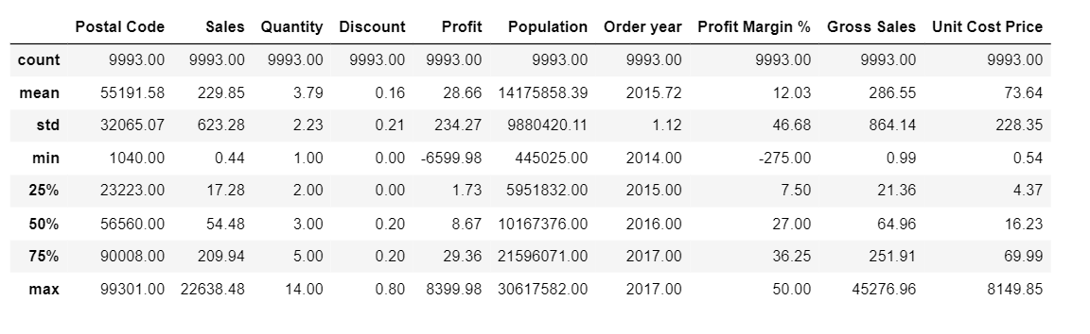
Title Page
Proprietors
Introduction
Review of Literature
Profit Margin
Descriptive Statistics
75% of orders make atleast 36% of the profit margin
Loss incurred
Highest loss on orders goes all the way to -275% that need to be cut off.

Slide 7


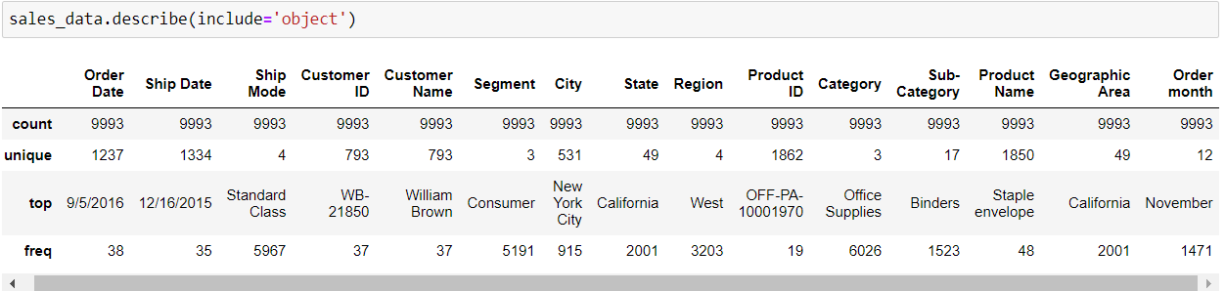
Title Page
Proprietors
Introduction
Review of Literature
Methodology
Product Demand
Shipping and Customer
The store carries 3 category of items with 17 sub-category. 60% of orders are for Office Supplies and at least 15% purchases are for Binders.
There are 4 ship modes and 3 customer segments. Nearly half of the orders are from Consumer segment using Standard Class shipment

Slide 8

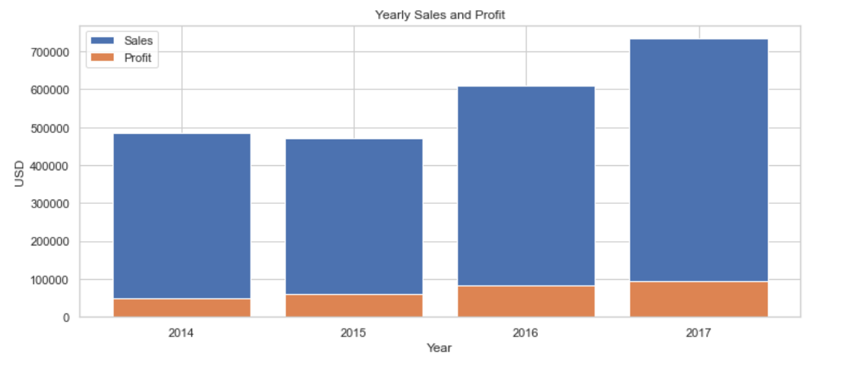
Title Page
Proprietors
Introduction
Review of Literature
Methodology
Results
Yearly Sales and Profit ( 2014 - 2017 )

Slide 9
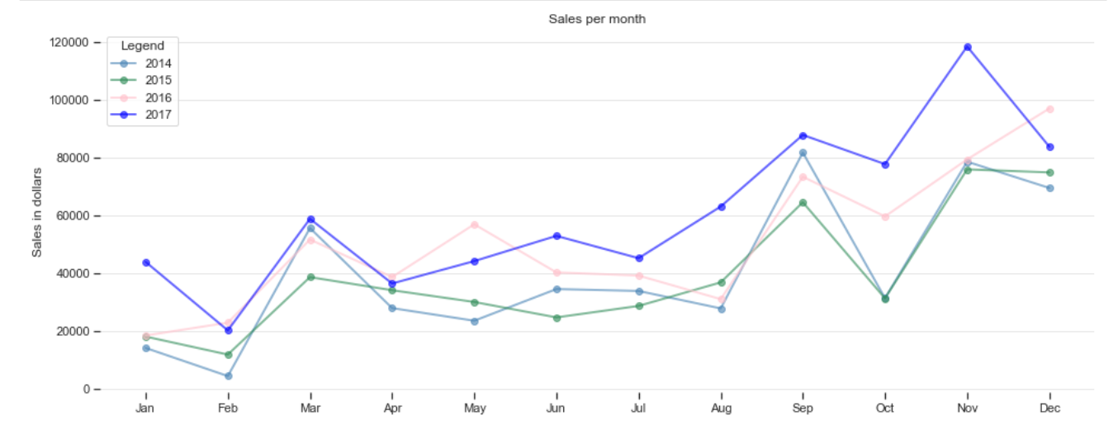
Title Page
Proprietors
Introduction
Review of Literature
Methodology
Results
Yearly Sales( 2014 - 2017 )

Slide 10
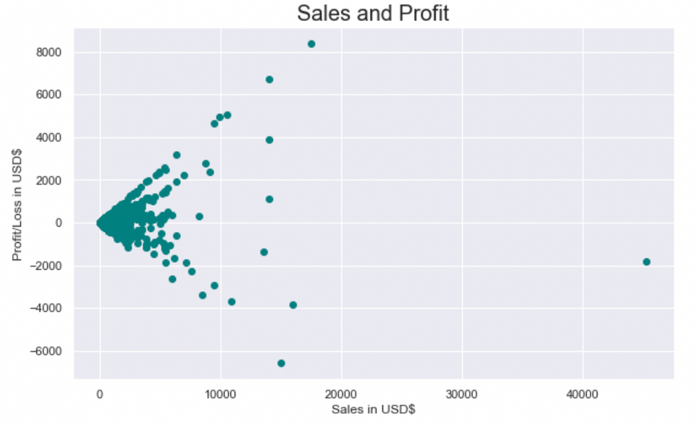
Title Page
Proprietors
Introduction
Review of Literature
Methodology
Results
Profit/Loss vs Sales
Most sales are less than USD 5k This is likely because a majority of the Superstore's customers are of the Consumer Segment - individuals who tend to buy and spend less than the other customer Segments comprising of groups and teams from Corporates and Home Offices.
Larger sales above USD 2.5k are very likely to result in a profit. Profit margins may be higher, after economies of scale in cost components such as procurement, packaging, and delivery

Slide 11
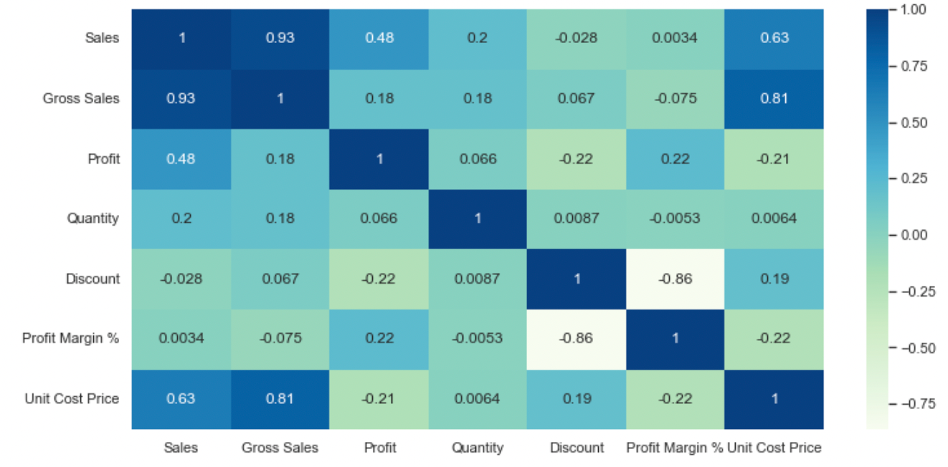
Title Page
Proprietors
Introduction
Review of Literature
Methodology
Results
CORRELATION MATRIX

Slide 12
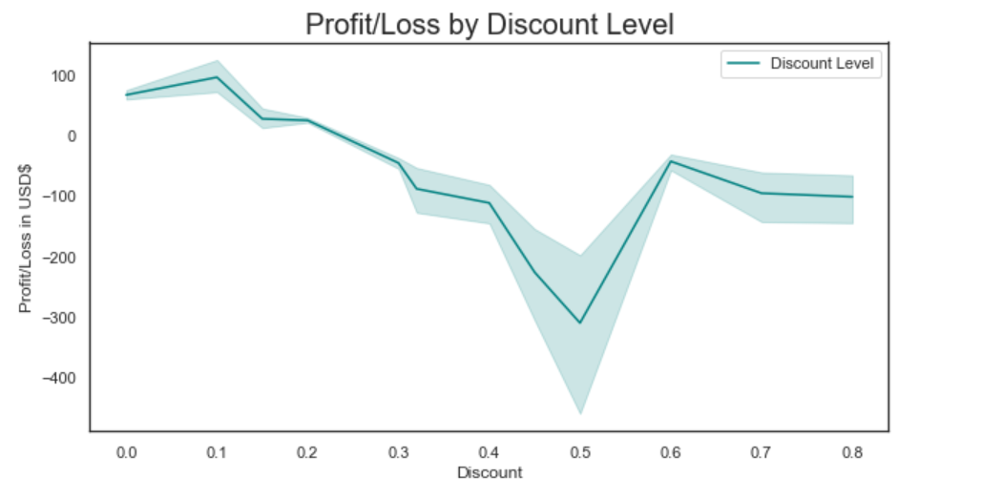
Title Page
Proprietors
Introduction
Review of Literature
Methodology
Results
Profit vs Discount Level
Superstore is more profitable when discount levels are 10% or lower.
At 50% discount, profit is the least.

Slide 13
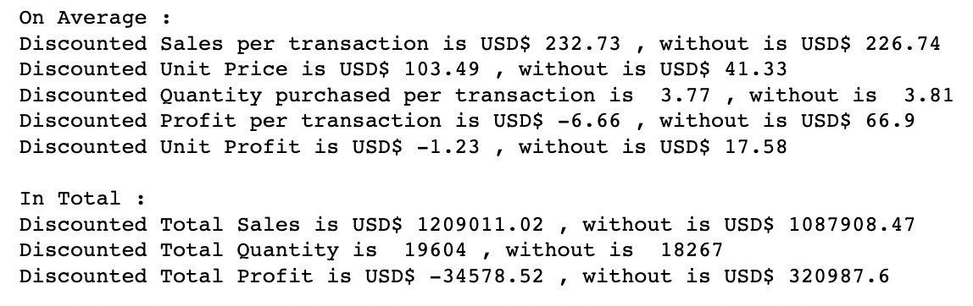
Title Page
Proprietors
Introduction
Review of Literature
Methodology
Results
Comparing discounted and non-discounted transactions
Considering both average and total sales, customers tend to spend more when there are discounts. An average sales transaction with discounted products is USD 233 as compared to a lower USD 227 where there are no discounts. In total, the difference amounts to a notable USD 200k increase in sales value when there are discounts
Superstore is advised to reduce overall discount levels to minimise losses, and focus on implementing other promotional strategies to ensure increasing profitable sales and consistent future gains in long term customers

Slide 14
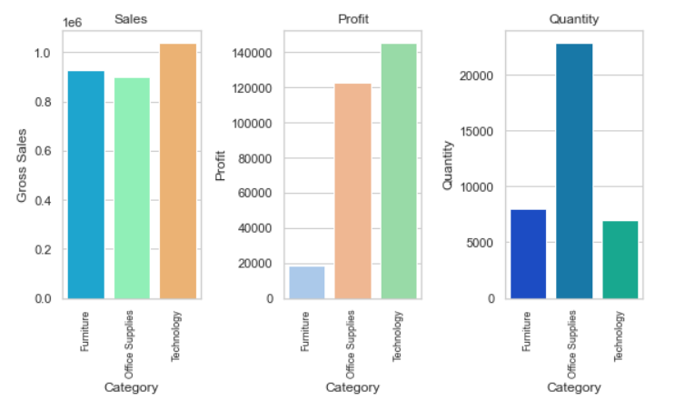
Title Page
Proprietors
Introduction
Review of Literature
Methodology
Results
Which Category is Best Selling and Most Profitable?
Product category-Technology shows the highest gross sales of $103K and profit of $145K.
The Unit price of the category-Technology to be highest is conclusive as it has the highest profit despite the least quantity sold.

Slide 15
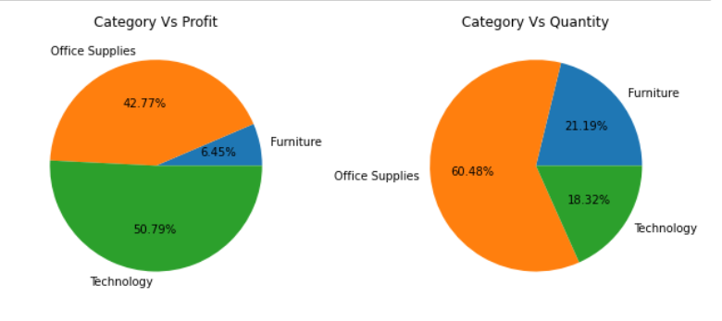
Title Page
Proprietors
Introduction
Review of Literature
Methodology
Results
Insights:
Profit and Quantity grouped by Category
Although Furniture makes similar sales as Technology, it is the least profitable. Technology products are purchased more frequent and at higher price than furnitures.
Office Supplies sells the most in terms of quantity as it is relatively cheap product.

Slide 16


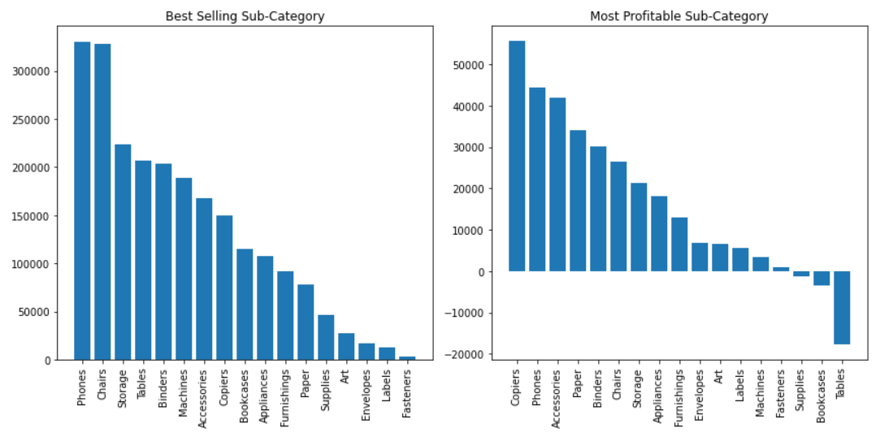

Title Page
Proprietors
Introduction
Review of Literature
Methodology
Results
Subcategory Products Performances- Best vs Worst Selling, Most profitable:
Front-runners
Copiers being a more intricate product sees the least bargain in price, followed by Phones.
Sink-holes
Super Store can consider dropping from the product catalogue of Tables, bookcases etc or bargain for a lower price from the supplier.

Slide 17
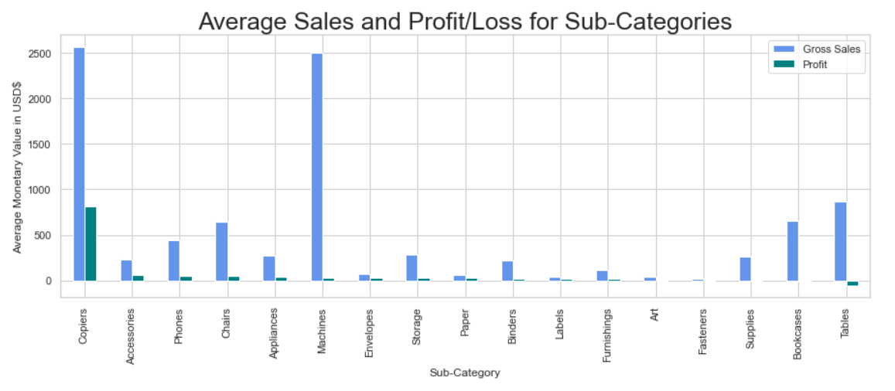

Title Page
Proprietors
Introduction
Review of Literature
Methodology
Results
Sales vs Profit/Loss for Subcategories:
Although the sales of Machines is the second highest, the profit incurred is significantly negligible in comparison due to the high average unit price.
Working with suppliers on lowering manufacturing cost or considering vertical integration will help reduce costs across different parts of its production process.

Slide 18

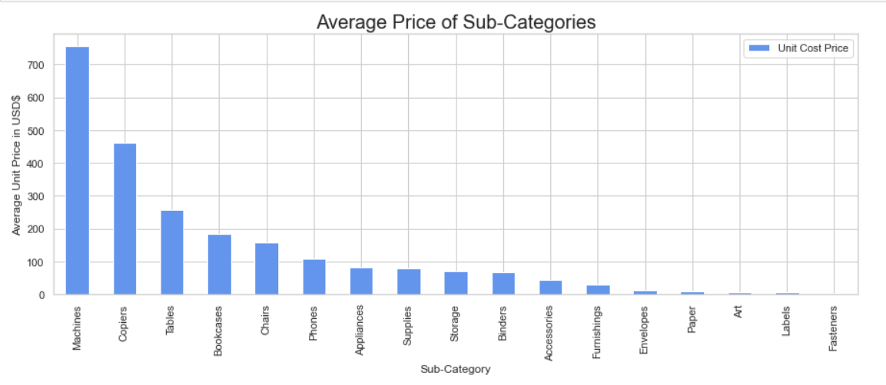
Title Page
Proprietors
Introduction
Review of Literature
Methodology
Results
Average Unit Price Estimation:
Estimated cost price per unit shows Tables to be the third highest(~$100) which helps us better understand that the sales of this subcategory is not significant and the superstore could consider discontinuing the product.
Storage and supplies are the most expensive sub-categories of around USD 75. While Storage contributes to the highest profitability for this category, supplies however has a loss incurring. Hence pricing restructure for the same must be considered.

Slide 19
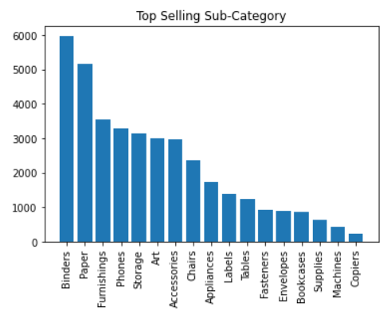


Title Page
Proprietors
Introduction
Review of Literature
Methodology
Results
Scope to Advance:
Pull back
Despite being most profitable, Copiers sell the least (only 234), but as it is a relatively expensive office equipment that is usually used for few years, it is understandable that it sells the least among all.
Push back
Super Store should ensure inventory are always well-stocked for the top selling sub-category such as Binders, Paper, Furnishings and Phones.

Slide 20
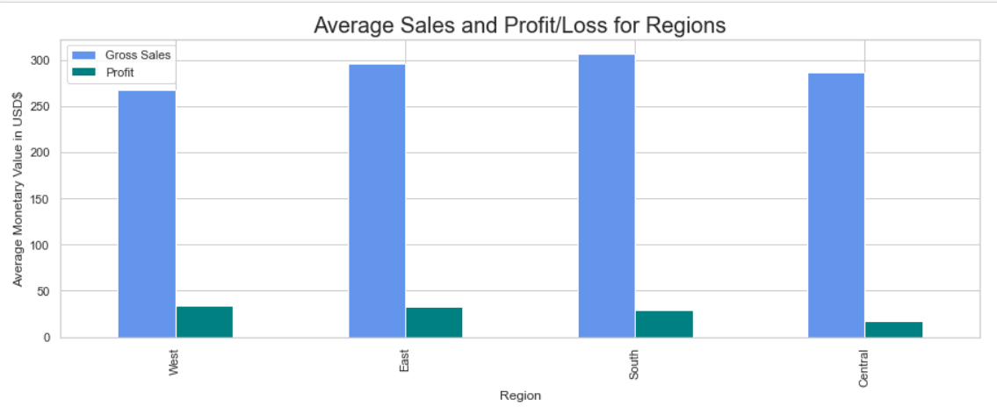
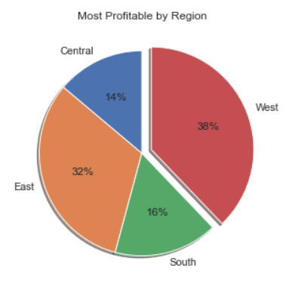
Title Page
Proprietors
Introduction
Review of Literature
Methodology
Results
Which Region is the Most Profitable?

Slide 21
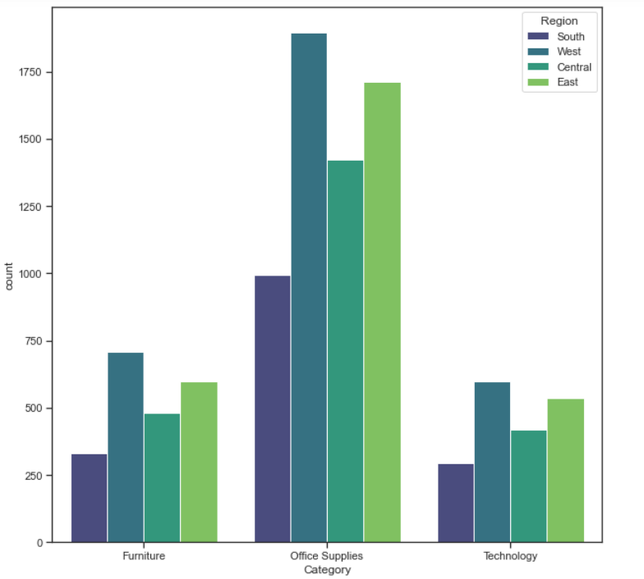
Title Page
Proprietors
Introduction
Review of Literature
Methodology
Results
Which Category is perfoming profitably in which Region?
Although West region's average sales are lower than that of east and south regions, profitability accounted with the west region is the maximum as Technology, which is the most profitable category is highest in the west.

Slide 22
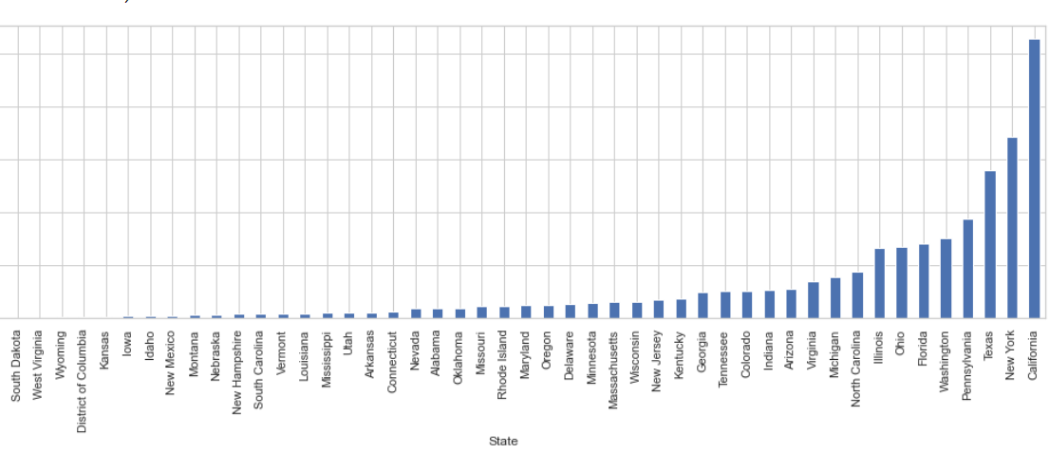
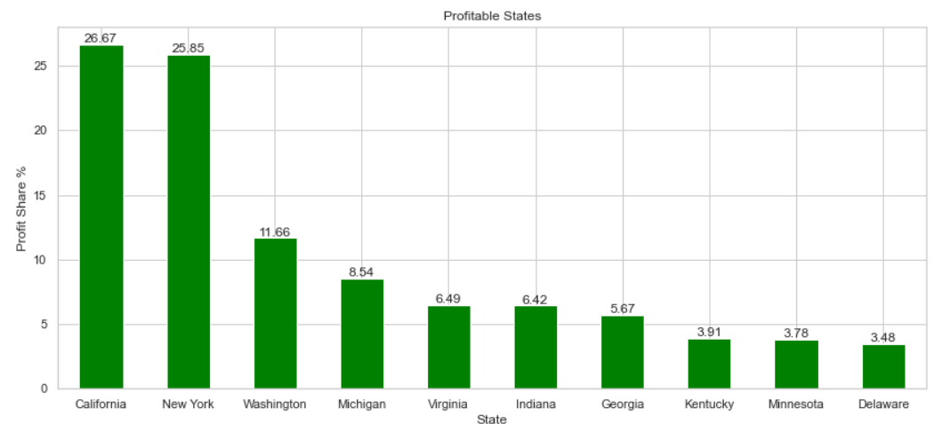
Title Page
Proprietors
Introduction
Review of Literature
Methodology
Which state has the Highest Sales?
California, New York and Texas have the highest sales and the first two contributed to more than 50% of the profitability of the store.

Slide 23
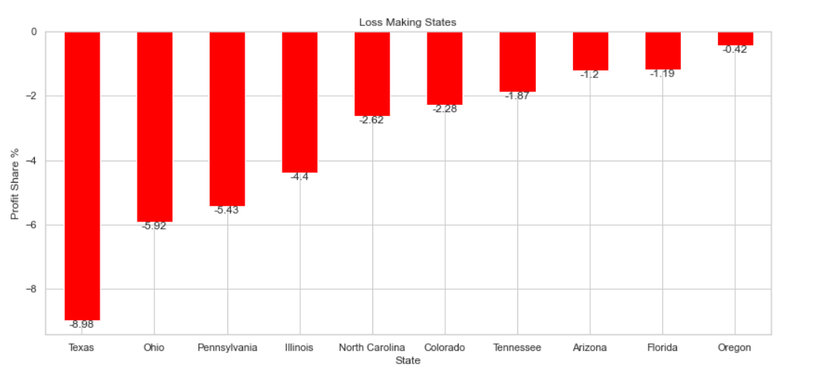
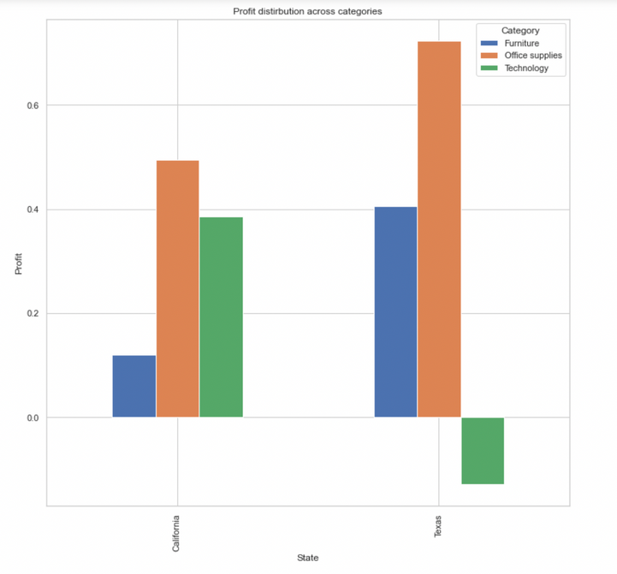
Title Page
Proprietors
Introduction
Review of Literature
Methodology
Loss Making Trend:
Even marking third highest in the sales, Texas has incurred the highest loss of around USD 25k. When comparing highest profitable with the highest loss incuring states, their sales across all categories are comparable. However, the overall profitability of in Texas in the least due to highest loss in high priced
Technology sector

Slide 24
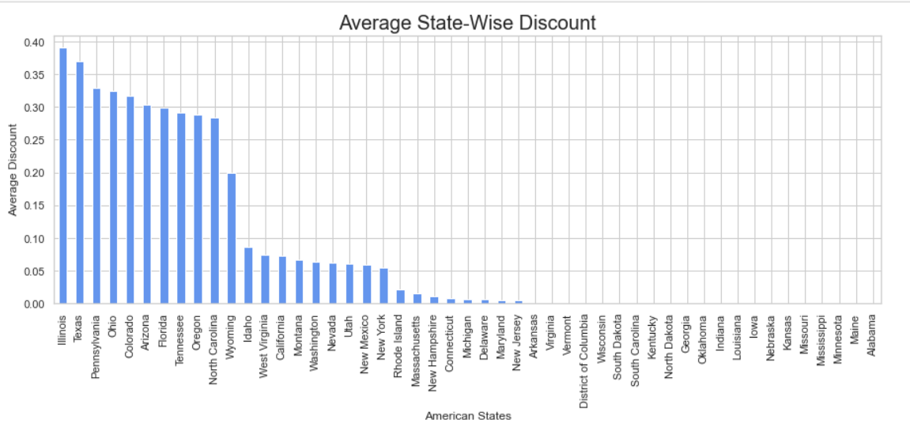
Title Page
Proprietors
Introduction
Review of Literature
Methodology
Loss Making Trend:
Pennsylvania, Illinois, and Ohio are the third, first, and fourth state offering larger discounts respectively, and this may be the reason behind them resulting in the third, fourth, and second biggest loss of around USD 15k. As in the previous point, Superstore is advised to switch to a different promotional strategy and reconsider
their inventory management.
Even marking third highest in the sales, Texas has incurred the highest loss of around USD 25k. This may be due to it having the second highest discount level. Superstore is advised to reduce

Slide 25
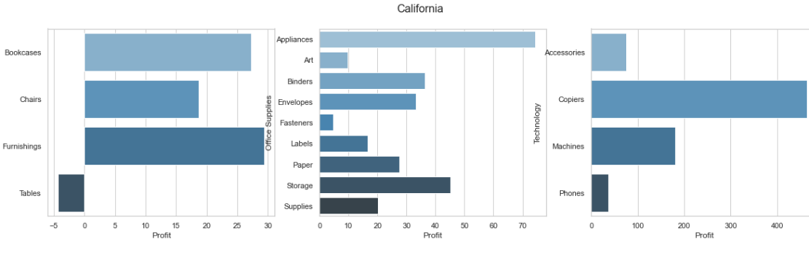
Title Page
Proprietors
Introduction
Review of Literature
Methodology
Results
Assessing profitability across buckets
After Bucketing the states into high, medium and low profits, a sample from each of these buckets were chosen and its corresponding profit/loss-making sub categories and categories were studied.
In high profit states such as California, all products sold across all categories and sub-categories are generating comparatively good profits, except for Tables in Furniture category which is suffering from an overall loss of USD 4 per unit sold. Superstore is advised to reduce discounts for Tables. The Technology category has the best performance

Slide 26
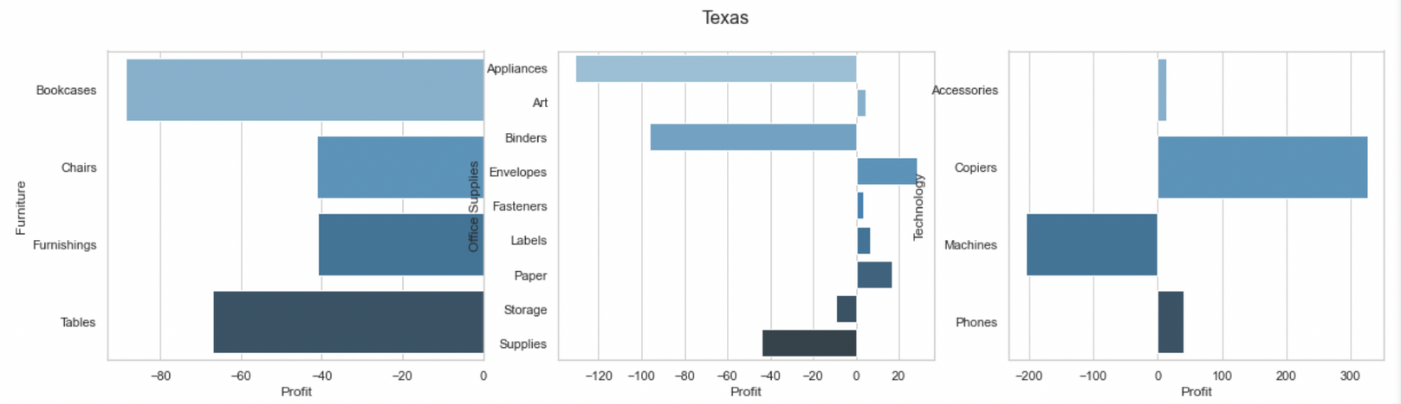
Title Page
Proprietors
Introduction
Review of Literature
Methodology
Results
Assessing profitability across buckets
In high loss states such as Texas, the Technology category has the best performance with Copiers making the highest profit of around USD 325 profit per unit sold, while the Furniture category's performance is going entirely in loss. Most sub-categories incur significant losses of up to USD 200, including Machines, Appliances, and Bookcases. Superstore is advised to reduce overall discounts, especially for Furniture.

Slide 27
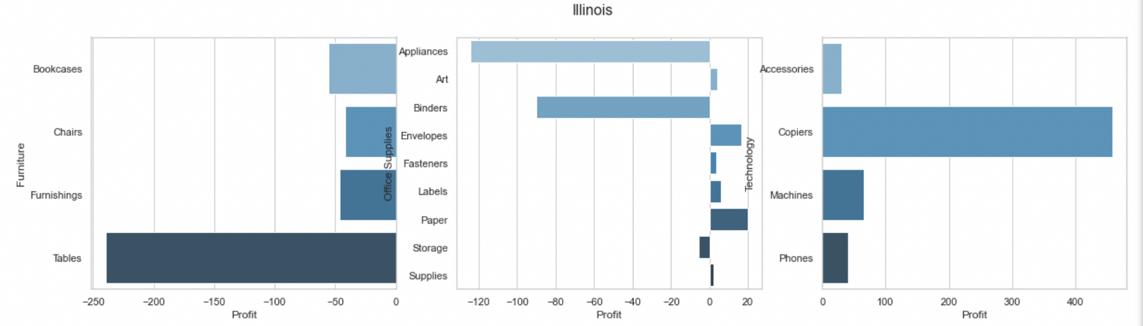
Title Page
Proprietors
Introduction
Review of Literature
Methodology
Results
Assessing profitability across buckets
In medium loss states such as Illinois, most sub-categories generate little to no profits, and those that suffer from up to USD 240 of notable losses are Tables, Appliances, and Binders. The Technology category has the best performance with Copiers making the highest profit of around USD 450 profit per unit sold. The Furniture category's performance is going entirely in loss. Superstore is advised to reduce overall discounts, especially for Furniture.

Slide 28
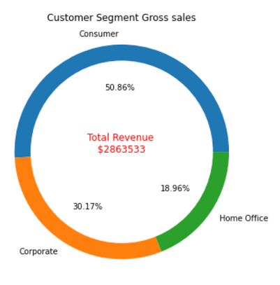
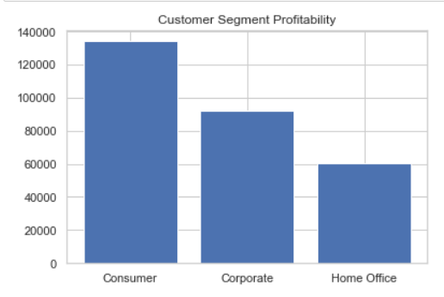
Title Page
Proprietors
Introduction
Review of Literature
Methodology
Results
Which Customer Segment is Most Profitable?
Leading
Consumer and Corporate Segment make up more than 80% of customerbase. Target them, especially customers from the East and West region in the Top 10 cities with Highest Sales by introducing special promotions and bundles for mass Consumer and Home Offices and send promotional emails or flyers.

Slide 29
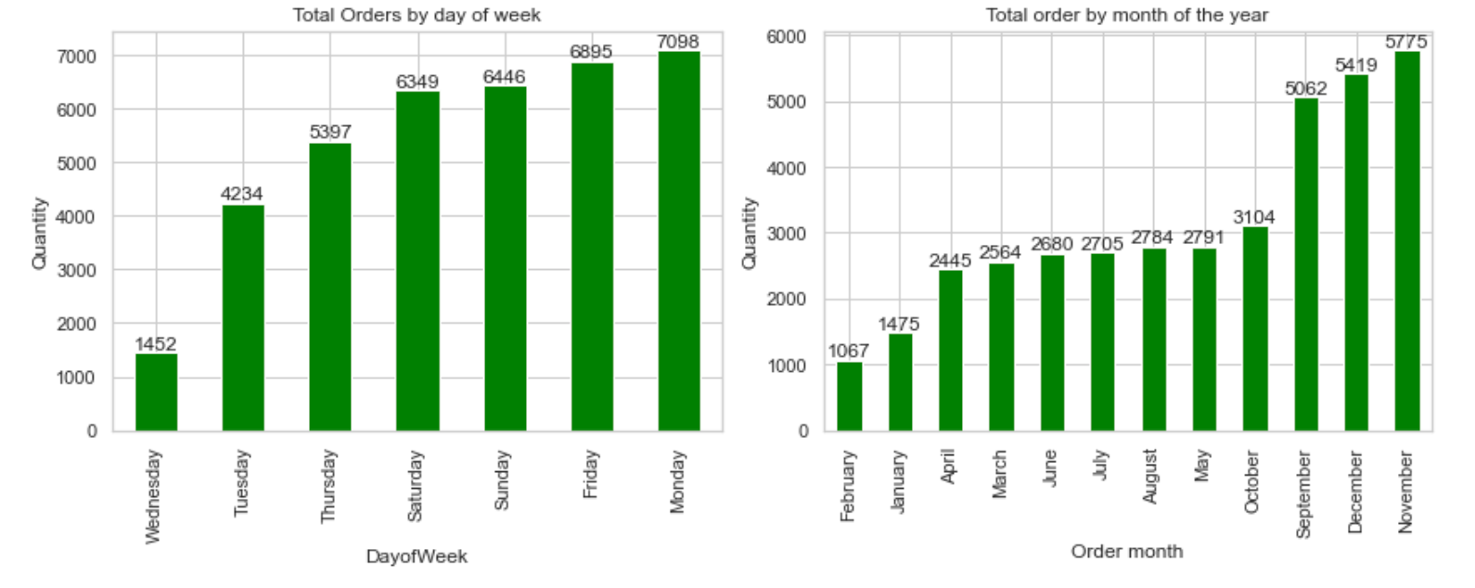
Title Page
Proprietors
Introduction
Review of Literature
Methodology
Results
Time Stamped Analysis
In each year, there were two month spikes whether customer ordered the most- November and December. Monday was the day that customers mainly ordered from the Superstore throughout the week.

Slide 30
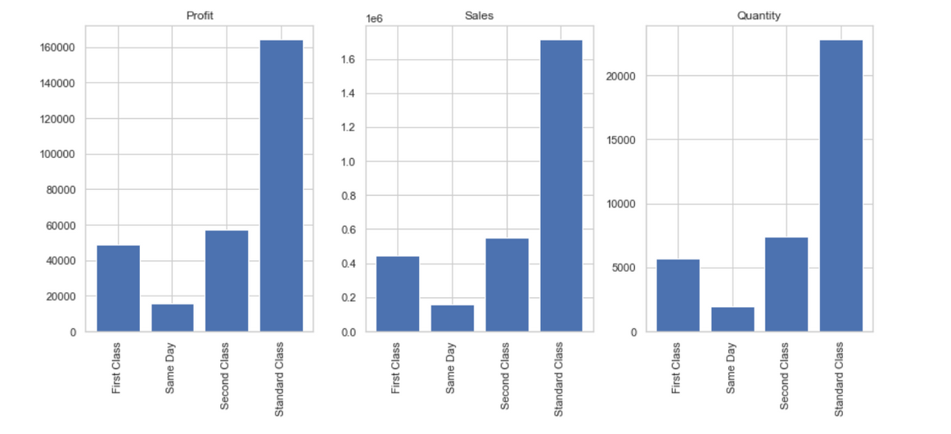
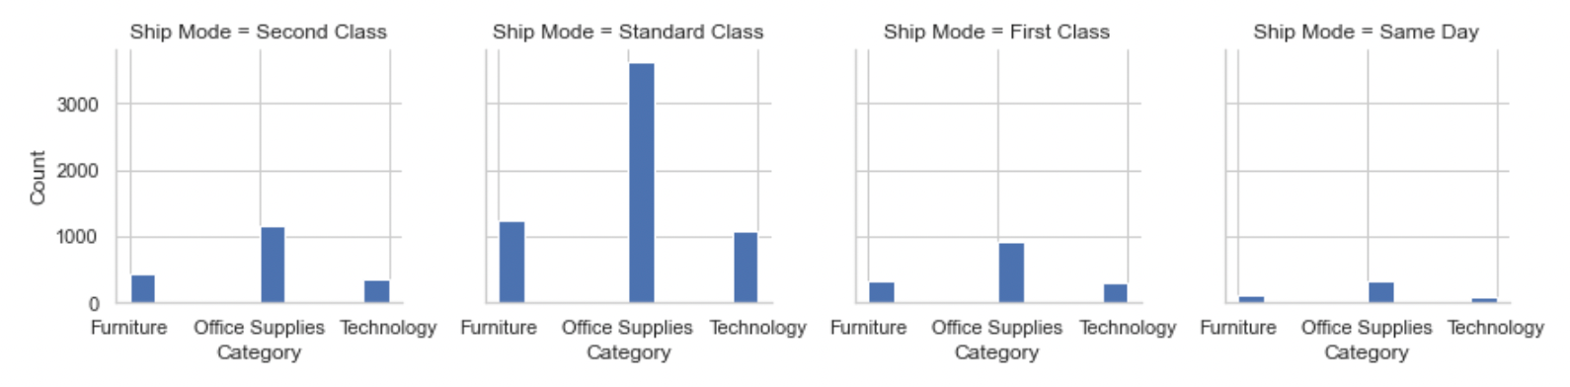
Title Page
Proprietors
Introduction
Review of Literature
Methodology
Results
Shipping Modes
Standard Class is the preferred method of shipment and perhaps the cheapest one too. The other modes are not popular among the customers and may be too costly.

Slide 31

Title Page
Proprietors
Introduction
Review of Literature
Methodology
Results
Conclusion
Conclusion - Data Analysis
Targeting Strategy:
The superstore should target Consumer segment customers as they represented the most sales & quantity of items ordered across all segments.
They should focus on selling Staples-related products as most customers ordered these from Superstores.
From a geographical point of view, they should target on US central and south Region, and run fewer discounts in high volume states like texas and Illinois to minimize loses
Marketing and Promotion:
The superstore should spend additional resources on ads in Q1 as we observed these months were the Months with the least Orders. They should put ads and special promotions on Wednesdays and Tuesdays as they recorded fewer sales

Slide 32
Title Page
Proprietors
Introduction
Review of Literature
Methodology
Results
Conclusion - Data Analysis
Superstore is most profitable when discount levels lower than 10% are offered. This allows fewer occurrences of lowered prices after discount deductions, and thus larger profit margins and profits
Run Promotionals Sales in October owing to its declining seasonality
The overall observed negative trend is that all Furniture sub-categories, as well as Appliances and Binders under the Office Supplies category, contribute to a majority of losses. Superstore is advised to improve on the promotional strategies for these, as well as reduce overall discounts

Slide 33


Title Page
Proprietors
Introduction
Review of Literature
Methodology
Results
Conclusion
References
OBJECTIVE SETTING
Compute sales objectives of each state for the subsequent calendar year (2018) based on the sales data for each Category and Segment combination.

Slide 34




Title Page
Proprietors
Introduction
Review of Literature
Methodology
Results
Factors used to calculate Objectives
Historical Sales
Trends
Untapped Potential

Slide 35
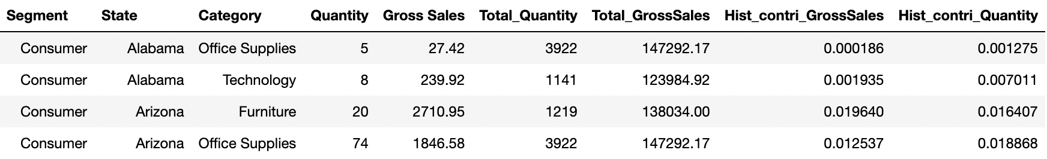
Title Page
Proprietors
Introduction
Review of Literature
Methodology
Results
Historical sales
The dataset comprises daily sales data starting from Jan 2014 to Dec 2017 . Based on the input baseline year, the historical component is calculated for each Segment-Category-State combination
The historical contribution is calculated for each of these states for a given Segment and Category

Slide 36
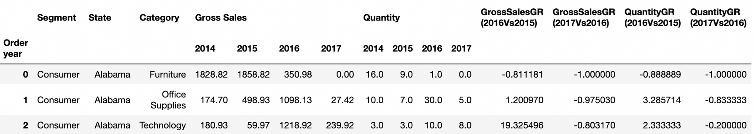
Title Page
Proprietors
Introduction
Review of Literature
Methodology
Results
Trended sales
Year on Year Growth rate analysis was performed for each of the States for a given Segment and Category
The average growth rate across years (2015-2017) was computed and applied to historical sales to determine the trend component for each state
The trend contribution is calculated for each of these states for a given Segment and Category

Slide 37
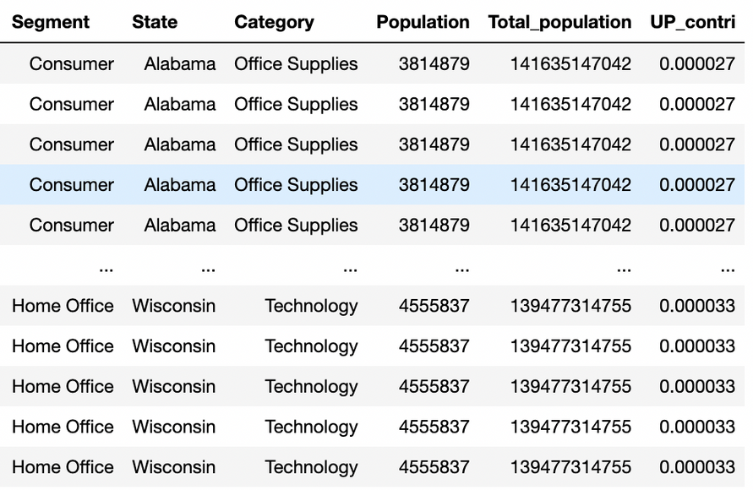
Title Page
Proprietors
Introduction
Review of Literature
Methodology
Results
Untapped Potential
Untapped Potential is calculated by taking the population belonging to the age group of 20-60 years from each state and its contribution is calculated against the total US population belonging to the same age group

Slide 38
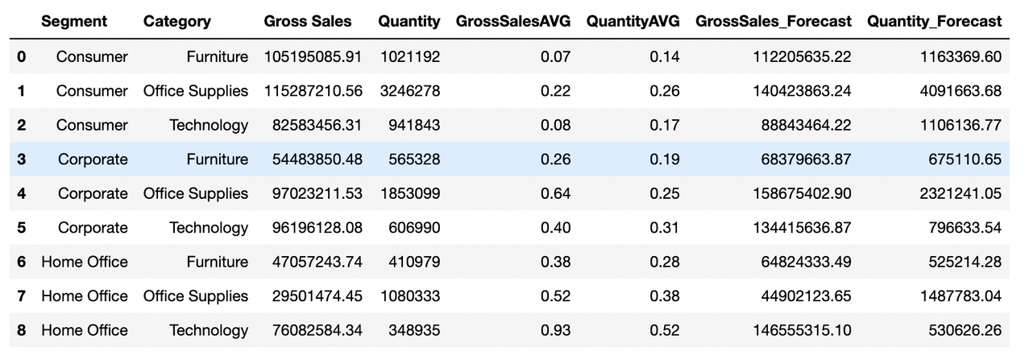
Title Page
Proprietors
Introduction
Review of Literature
Methodology
Results
Forecast Calculation
At the Nation level (US) , the average year-on-year growth rate is computed for each Segment-Category combination
The computed growth rate is applied on historical sales to obtain the forecast for each Segment-Category set

Slide 39

Title Page
Proprietors
Introduction
Review of Literature
Methodology
Results
Objectives Calculation
Input weights for each of the three factors i.e., History, Trends, and Untapped potential.
Based on input weights, weighted contributions are calculated and accordingly applied to the final forecast for each Segment and Category
The final yearly objectives are obtained for each Segment, Category, and State

Slide 40

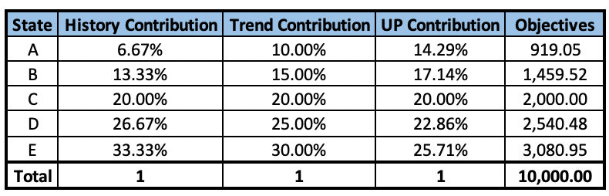
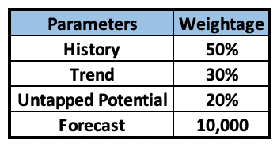
Title Page
Proprietors
Introduction
Review of Literature
Methodology
Results
Objectives Calculation - Example
Objectives (A) = (History(A)*0.5 + Trend(A)*0.3 + UP(A)*0.2)*Forecast

Slide 41
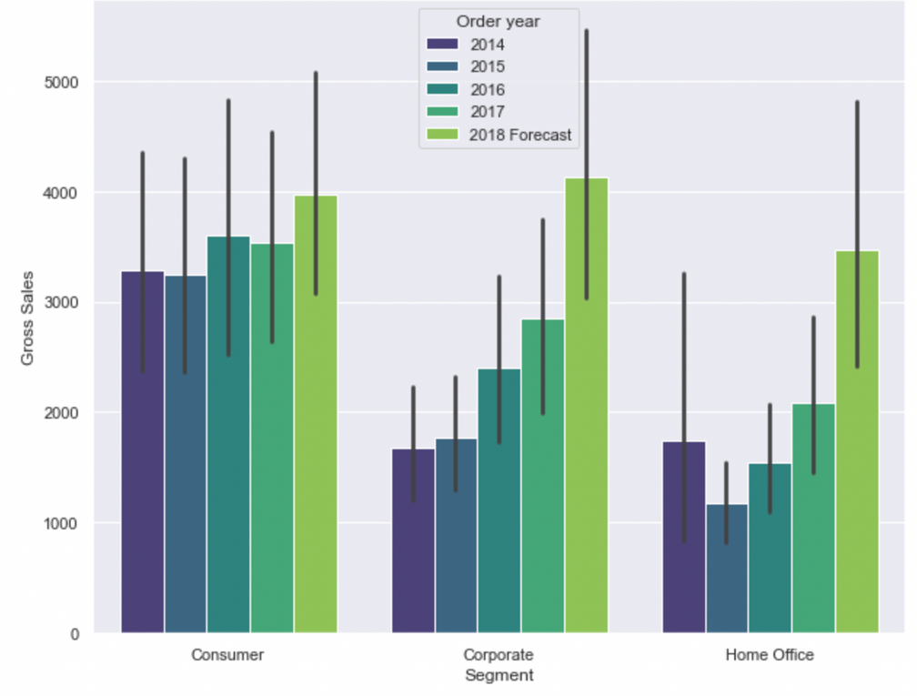
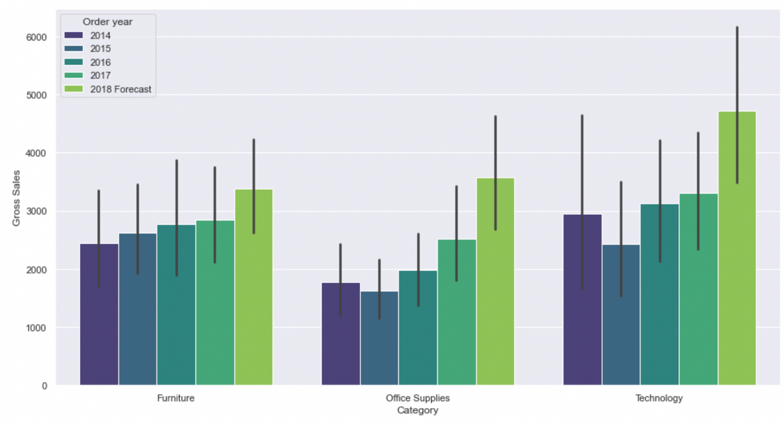
Title Page
Proprietors
Introduction
Review of Literature
Methodology
Results
Forecast Analysis - 2018
On comparing the sales year-wise across Segments and categories, we can observe that 2018 has assumed a nominal growth rate considering 2017 as the baseline

Slide 42
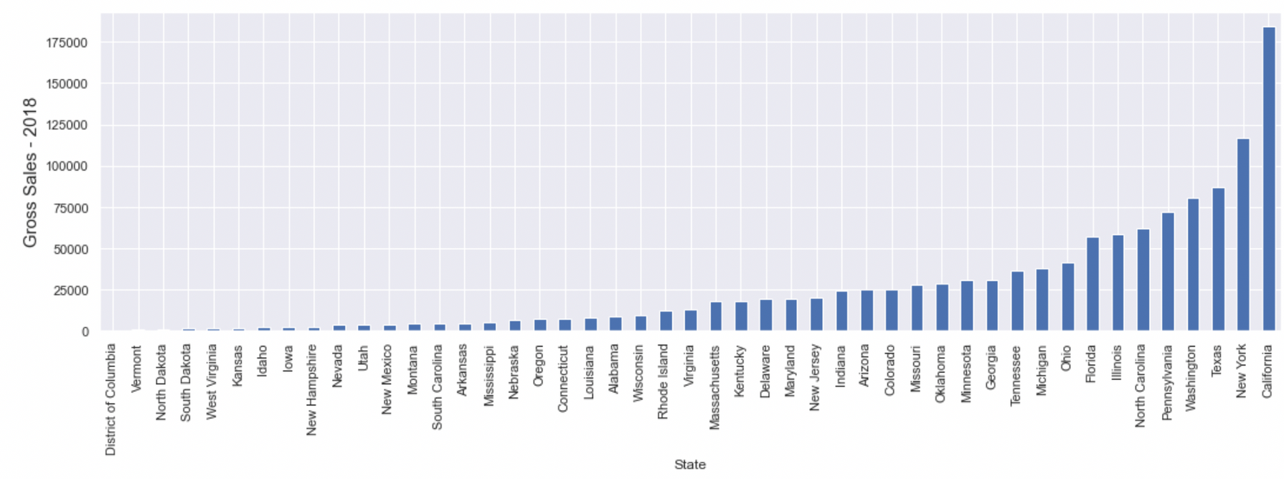
Title Page
Proprietors
Introduction
Review of Literature
Methodology
Results
Forecast Analysis - 2018
The 2018 sales forecast follow the same trend across states as that of the previous three years on average assuming no major market fluctuations

Slide 43
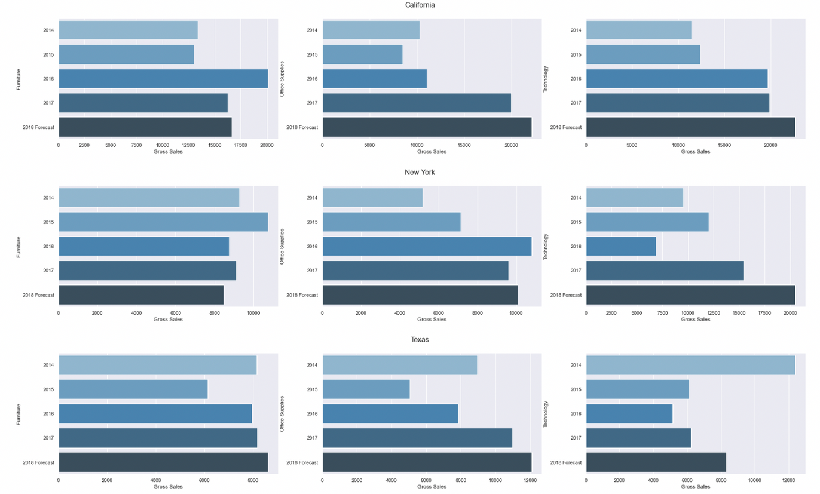
Title Page
Proprietors
Introduction
Review of Literature
Methodology
Results
Forecast Analysis -2018
For the top 3 cities, we can observe the 2018 numbers are on an increasing trend across various categories except the furniture segment in new york which saw a steep decline from 2015 to 2016

